Slide 1

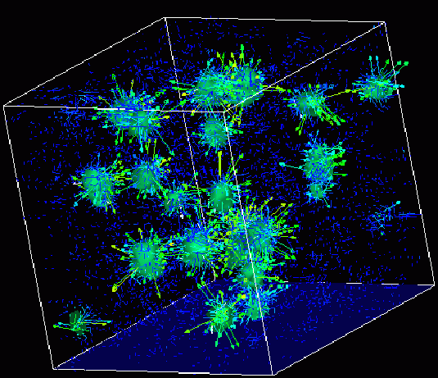

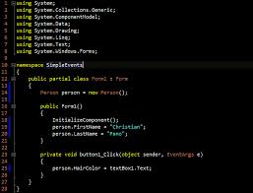
Survey of
Scientific Computing
(SciComp 301)
Dave Biersach
Brookhaven National Laboratory
dbiersach@bnl.gov
Session 07
Creating a New Project

Slide 2
Session Goals
Demonstrate step-by-step how to create a “starter” (blank) C++/14 console application using the Code::Blocks IDE
Explain the purpose of the stdafx.h file and how to add it to a Code::Blocks project
Review the bubble sort algorithm and how it can order the elements of a given vector
Introduce Euler’s Totient function which returns the number of positive integers less than a given integer that are relatively prime to that integer
Write code to implement Heron’s Formula and to calculate basic statistics of a vector of random integers

Slide 3
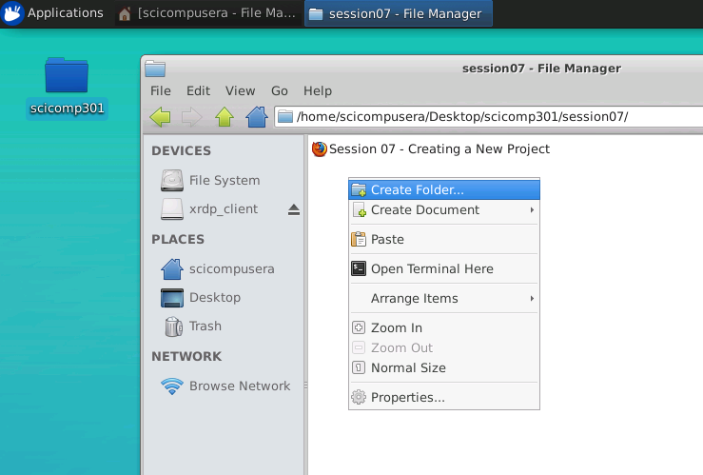
Create lab1 subfolder in session07 folder
Right click on an open spot in the session07 folder then select
Create Folder…

Slide 4
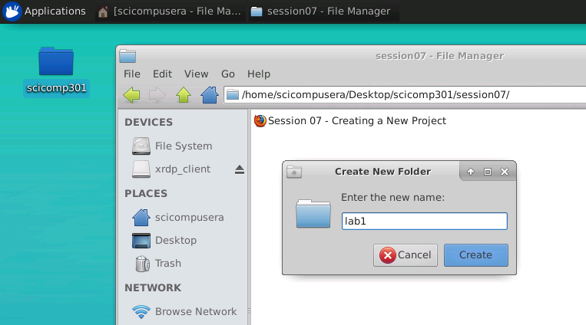
Create lab1 subfolder in session07 folder
Type lab1 then
click Create

Slide 5
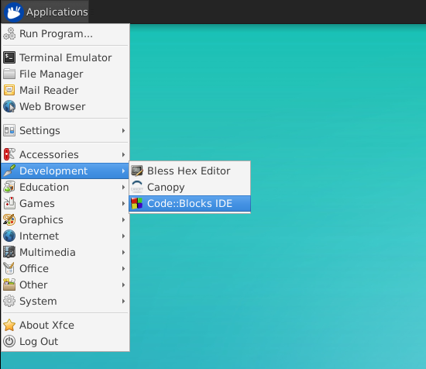
Launch the Code::Blocks
Integrated Development Environment (IDE)
From Applications select Development and then Code::Blocks IDE

Slide 6
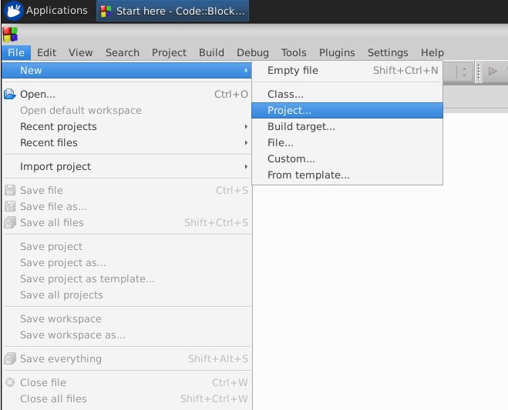
Create a New Project in Code::Blocks
Select the File…New…Project… menu options

Slide 7
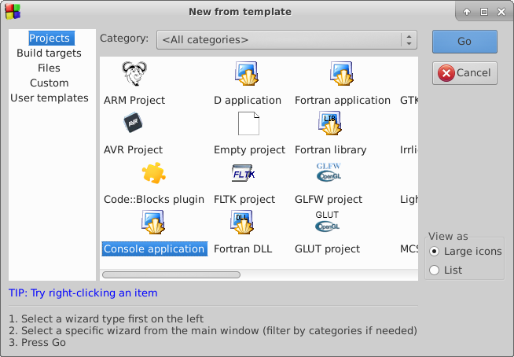
Create a New Project in Code::Blocks
Select
Console application
and then click Go

Slide 8
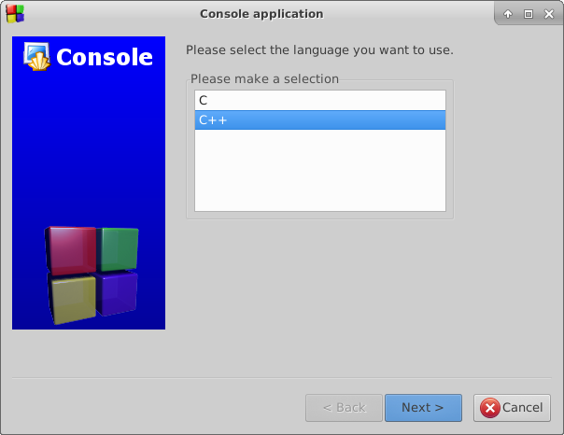
Create a New Project in Code::Blocks
Ensure C++ is selected, then click Next

Slide 9
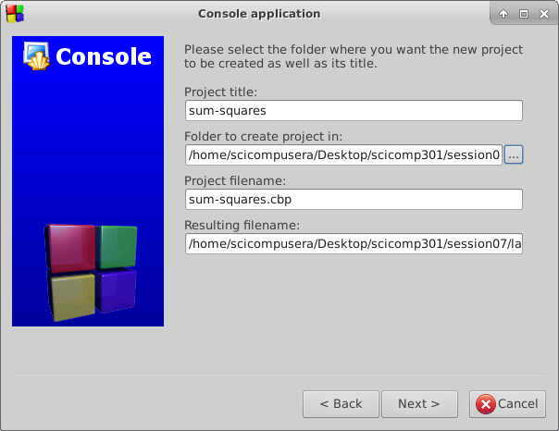
Set appname and project folder location
Don’t use spaces in your appname!
Instead use hyphens as a word breaker
Ignore for now anything appearing in these bottom three boxes
Click on the ellipsis to open a file system navigator dialog box

Slide 10
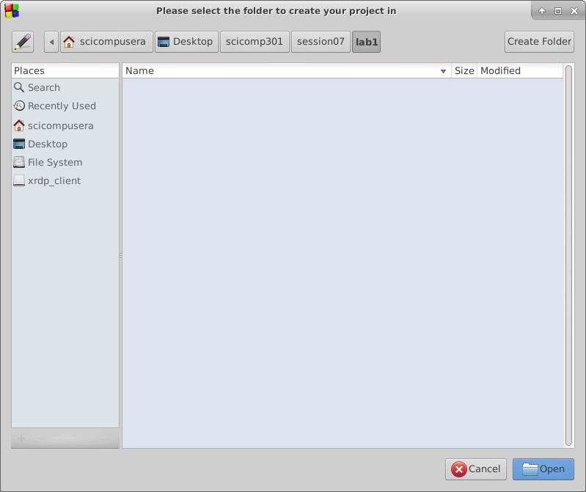
Set appname and project folder location
Then keep drilling down until you are in the Desktop/scicomp301/session07/lab1 folder
Start by click on “Desktop”
Then click on “Open”

Slide 11
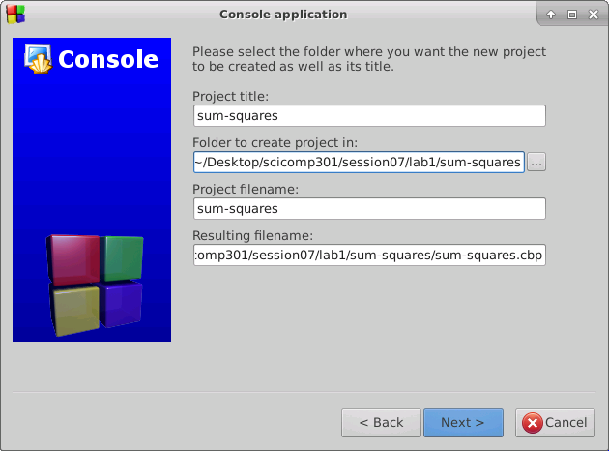
Set appname and project folder location
Ensure the resulting filename box ends with this path:
/Desktop/scicomp301/session07/lab1/sum-squares/sum-squares.cbp
Then click on “Next”

Slide 12
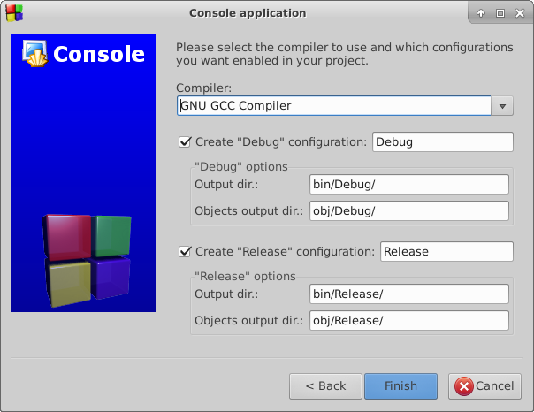
Accept Default Configurations
Simply accept the default configurations by clicking Finish

Slide 13
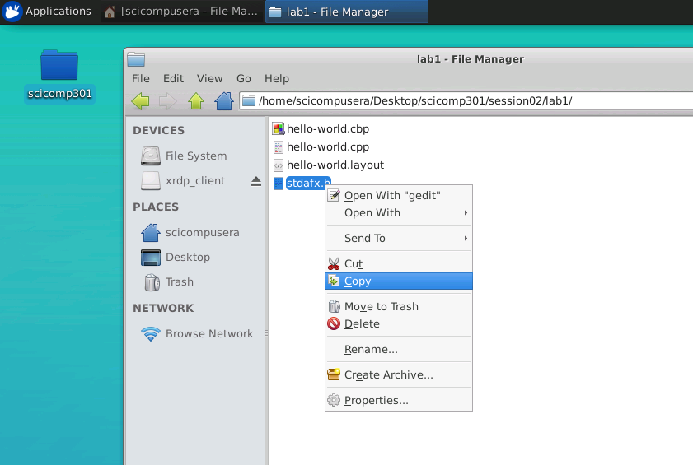
Copy “stdafx.h” file to your appname folder
Open the folder ~/Desktop/scicomp301/session02/lab1
then right click on the stdafx.h file, and
then select Copy

Slide 14
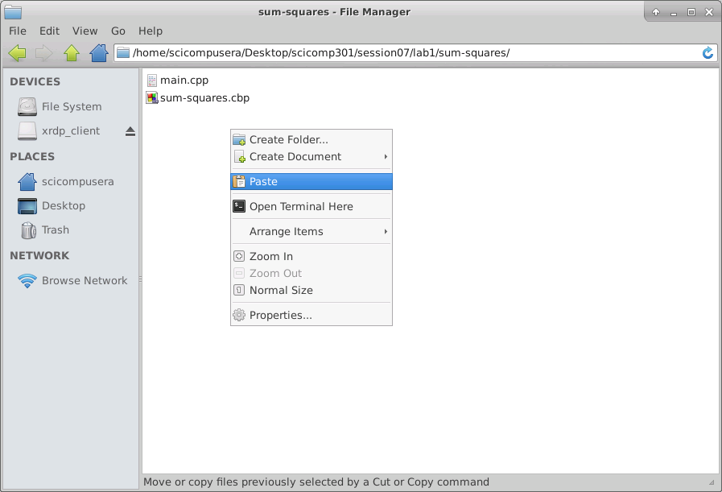
Copy “stdafx.h” file to your appname folder
Right click anywhere in the ~/Desktop/scicomp301/session07/lab1/sum-squares
folder and select Paste

Slide 15
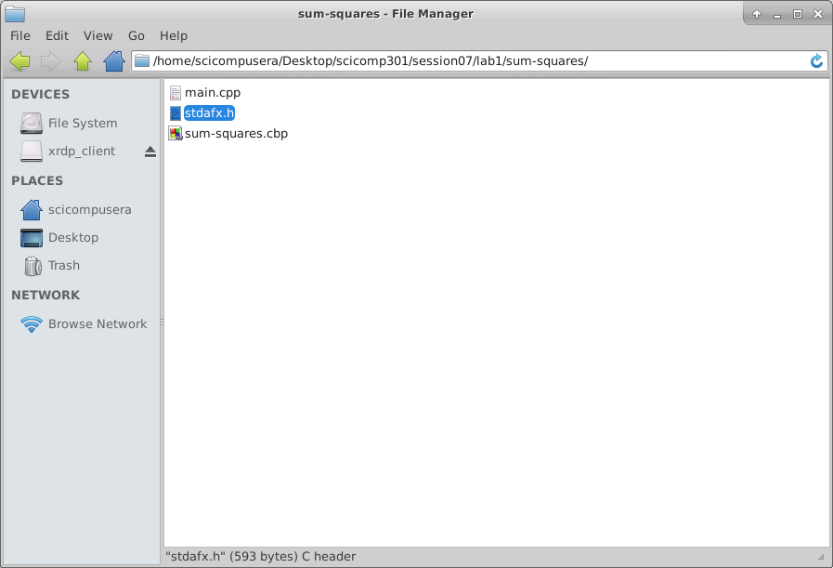
Copy “stdafx.h” file to your appname folder
Ensure the stdafx.h file is in the same folder as the main.cpp file created by Code::Blocks

Slide 16
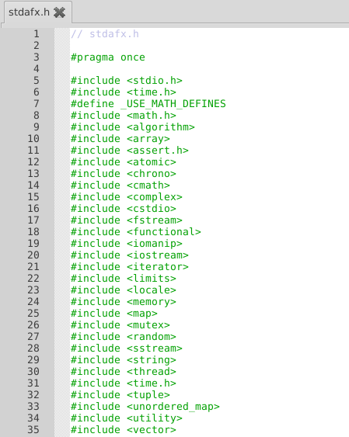
stadafx.h – The Standard Application Framework Header File
The stdafx.h file includes other header files. Header files (.h) contain variable & function declarations used in the source (.cpp) files in your project. These particular header files cover all of the C++ functions we will likely need for our labs

Slide 17
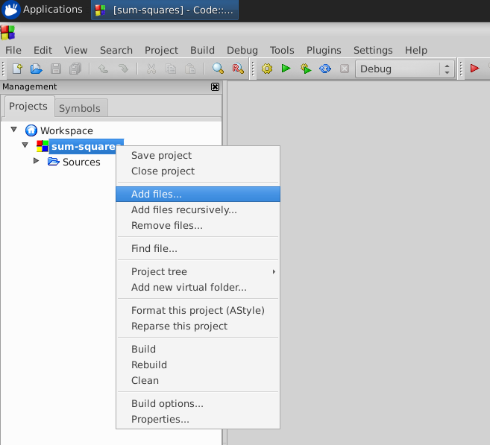
Add “stdafx.h” file to your project
Right click on your project folder, and select Add files…

Slide 18
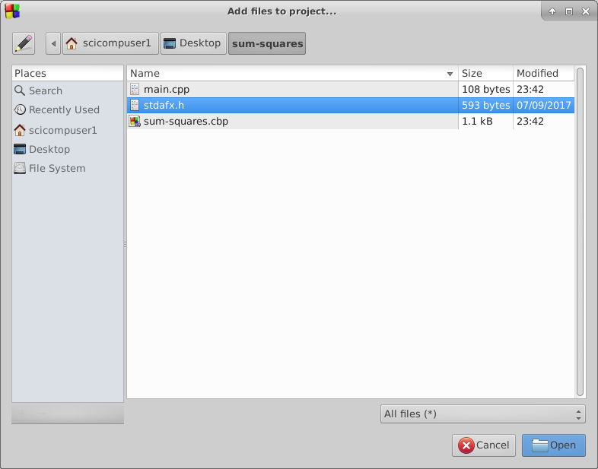
Add “stdafx.h” file to your project
Select stdafx.h and then click Open

Slide 19
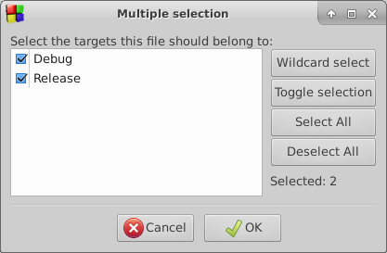
Add “stdafx.h” file to your project
Accept the default targets by clicking OK

Slide 20
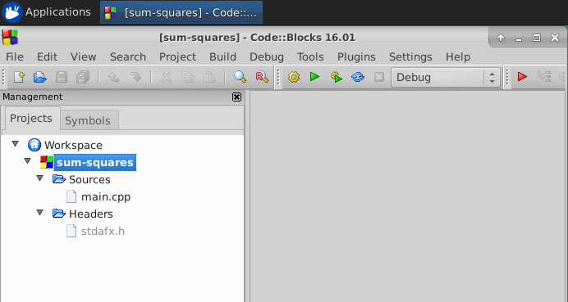
Add “stdafx.h” file to your project
A Headers branch will be added to the Management pane

Slide 21
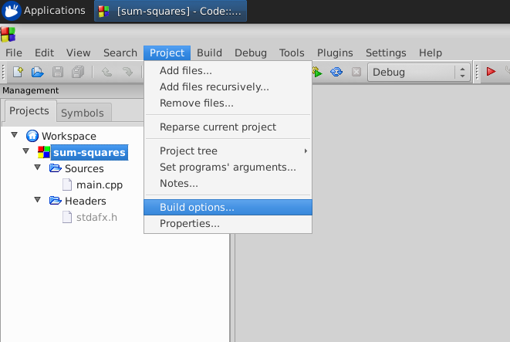
Set Project Build Options
Select Project…Build options… from the main Code::Blocks menu

Slide 22
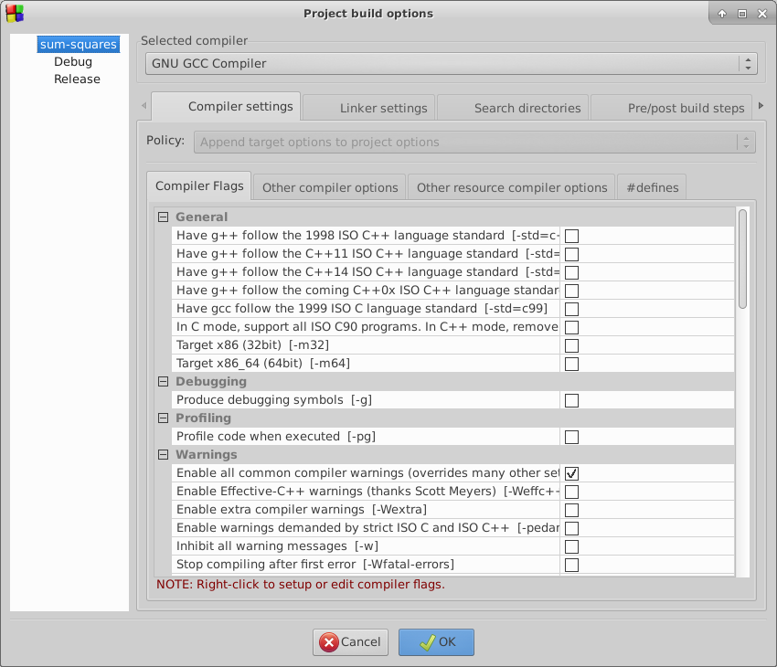
Set Project Build Options
Select your appname
in the top row in the
left-hand tree list

Slide 23
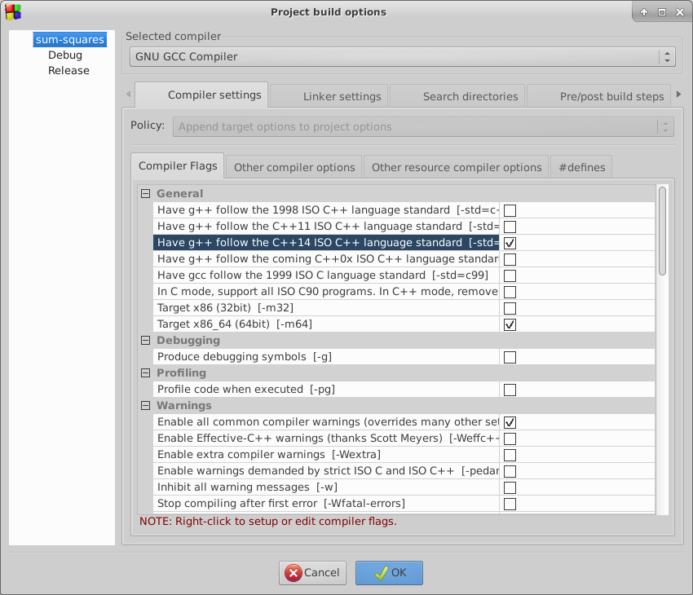
Set Project Build Options
Check both options:
Have g++ follow the C++14 ISO…
Target x86_64 (64bit)…
then click OK

Slide 24
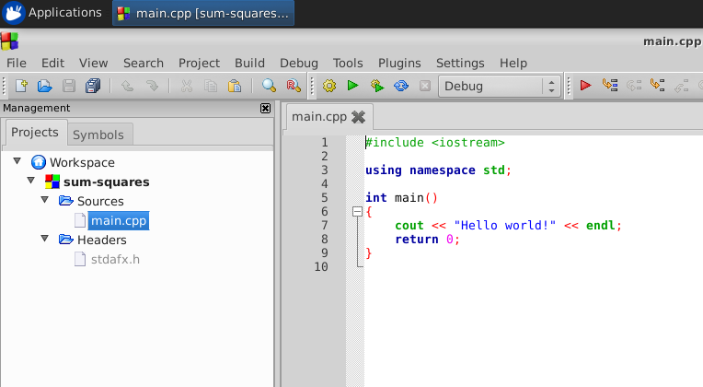
Edit “main.cpp”
Open the Sources leaf and double click on main.cpp to edit the primary source code file

Slide 25
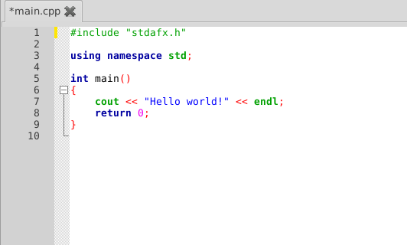
Edit “main.cpp”
In line # 1, remove
<iostream>
and replace it with
“stdafx.h”
(Note: you must enclose the filename in double quotation marks)

Slide 26
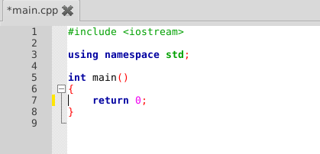
Edit “main.cpp”
Delete line # 7
cout << “Hello World”

Slide 27
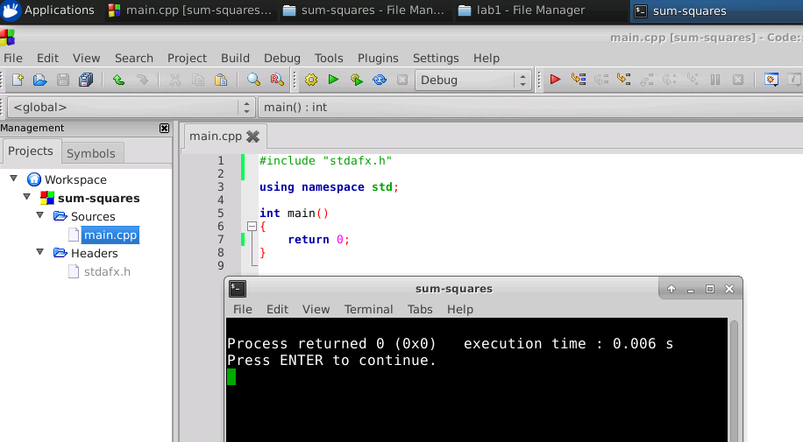
Edit “main.cpp”
Build and run this minimalist program to verify all the project settings
Be sure to explicitly close this app by pressing ENTER or click the window X

Slide 28


Lab 1 – Sum of Squares
Write a program to calculate the sum of the squares of the first 1000 natural numbers
n | n^2 | Sum
1 | 1 | 1
2 | 4 | 5
3 | 9 | 14
4 | 16 | 30
5 | 25 | 55
6 | 36 | 91
7 | 49 | 140
8 | 64 | 204
9 | 81 | 285
10 | 100 | 385

Slide 29
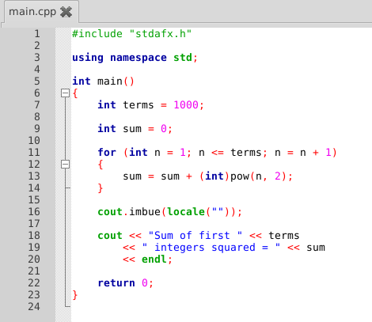
Lab 1 – Sum of Squares

Slide 30
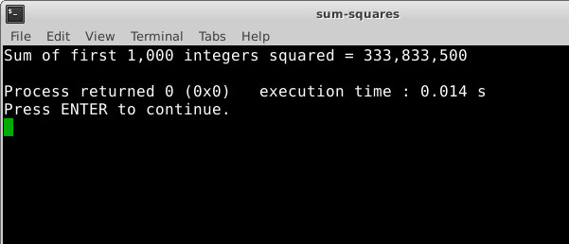
Lab 1 – Sum of Squares
Write a program to calculate the sum of the squares of the first 1000 natural numbers

Slide 31
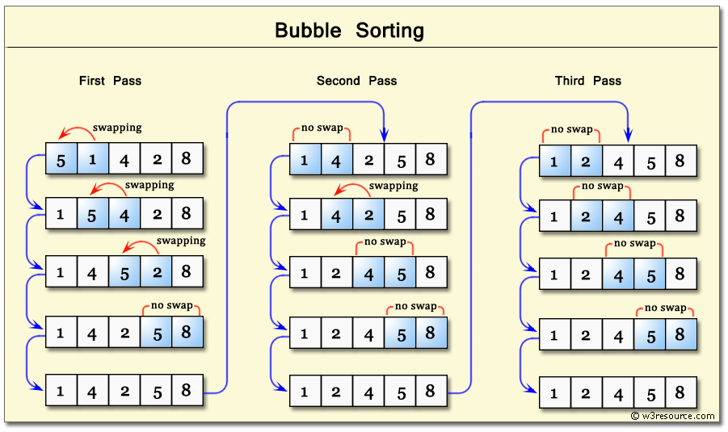
Lab 2 – Bubble Sort

Slide 32
Lab 2 – Bubble Sort
Create a new Code::Blocks C++/14 console application project called bubble-sort located at this path:
~/Desktop/scicomp301/session07/lab2/bubble-sort/bubble-sort.cpb
Your code should initialize a vector of 100 random integers (uniform distribution) each having a value between 1 and 100 inclusive with an initial seed value of 2016
Your code should first display all the elements in the unsorted vector
Your code should then bubble sort the vector in increasing order (lowest items move the front of the vector)
Finally your code should display all the elements in the sorted vector

Slide 33
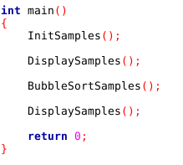
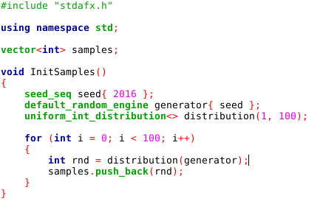
Lab 2 – Bubble Sort
push_back() appends the value in parenthesis to the end of the given vector

Slide 34
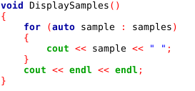
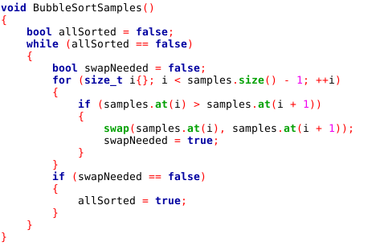
Lab 2 – Bubble Sort

Slide 35
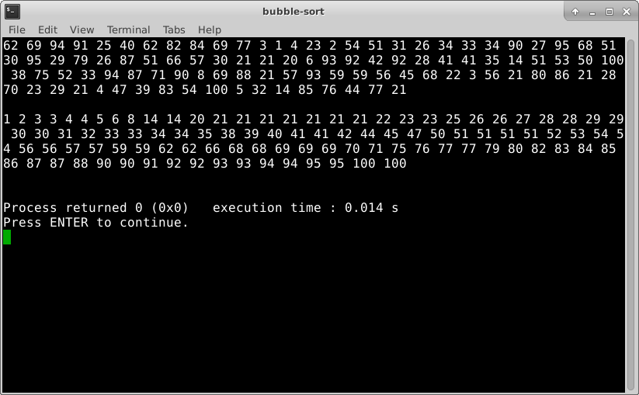
Lab 2 – Bubble Sort

Slide 36
Lab 3 – Euler’s Totient
Create a new Code::Blocks C++/14 console application project called euler-totient located at this path:
~/Desktop/scicomp301/session07/lab3/euler-totient/euler-totient.cpb
Using the GCD function, your code should calculate Euler’s Totient for all integers between 2 and 100 inclusive
The totient of an integer is the “number of positive integers” less than the given integer that are relatively prime to that integer
Totient(12) = 4 because only {1, 5, 7, 11} are relatively prime to 12
http://www.wolframalpha.com/input/?i=totient(12)
Your program should display only those integers whose value exceeds its own totient value by 1 exactly
What do you notice about those integers that are displayed?

Slide 37
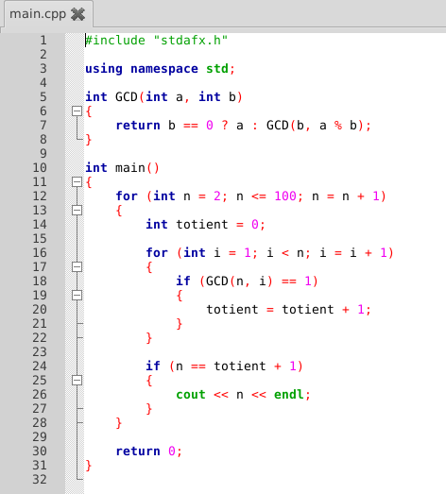
Lab 3 – Euler’s Totient

Slide 38
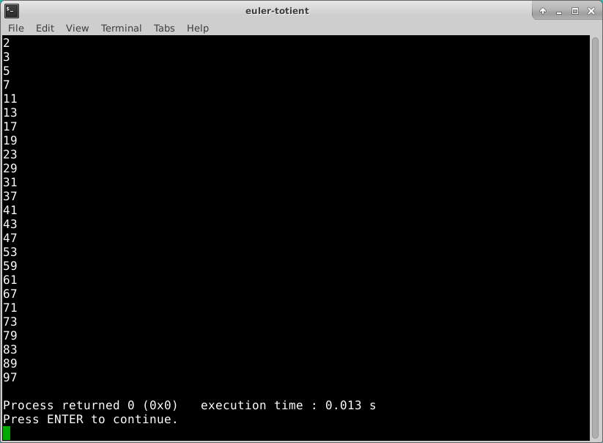
Lab 3 – Euler’s Totient
What do you notice about those integers that exceed their totient value by 1?

Slide 39
Lab 4 – Heron’s Formula
Create a new Code::Blocks C++/14 console application project called herons-formula located at this path:
~/Desktop/scicomp301/session07/lab4/herons-formula/herons-formula.cpb
Use Heron’s Formula to calculate and display the lengths of every side and the area of 10 random triangles
The length of each side of each triangle should be a uniformly distributed random integer within [1, 100]
Use the triangle inequality theorem to exclude any invalid triangle from your list of 10
Include any degenerate triangles in your list of 10

Slide 40
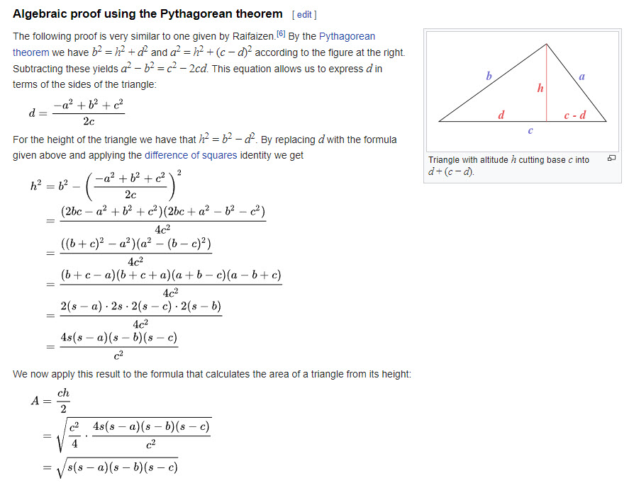

Deriving Heron’s Formula

Slide 41
Lab 5 – Statistics
Create a new Code::Blocks C++/14 console application project called statistics located at this path:
~/Desktop/scicomp301/session07/lab5/statistics/statistics.cpb
Generate and display a vector of 10 uniformly distributed random integers all between 0 and 100 inclusive, using a PRNG seed of 2016
Calculate and display the following five (5) population statistics that describe the vector:
Mean
Median
Mode
Variance
Standard Deviation

Slide 42
Now you know…
How to create a “starter” (blank) C++/14 console application using the Code::Blocks IDE
The purpose of the stdafx.h file and how to add it to a Code::Blocks project
How the bubble sort algorithm can order the elements of a given vector
Euler’s Totient function returns the number of integers less than a given integer that are relatively prime to that integer
The median is a tricky statistic depending if you have an odd or even number of elements in your set
Finding the mode requires counting element occurrences

